Slide 1


COVID-19 UPDATE
COVID-19 Nutrition Updates
Lindsay Christensen, MS, CNS
April 24th, 2020
©2020 All Rights Reserved, California Center for Functional Medicine

Slide 2
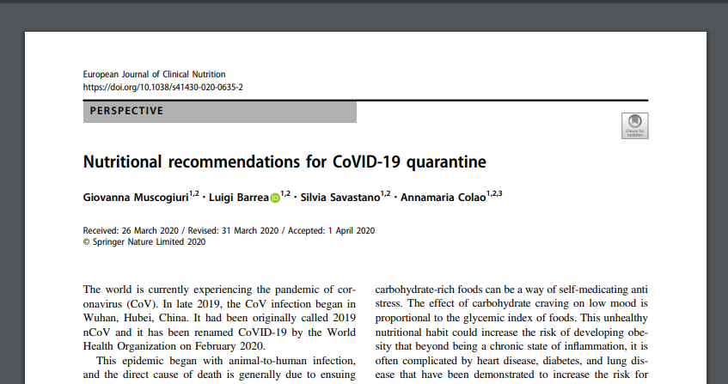
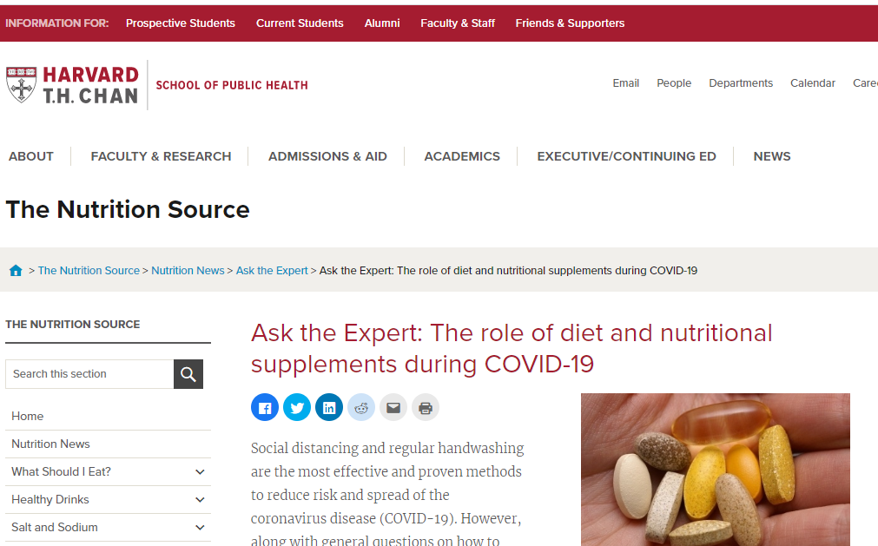
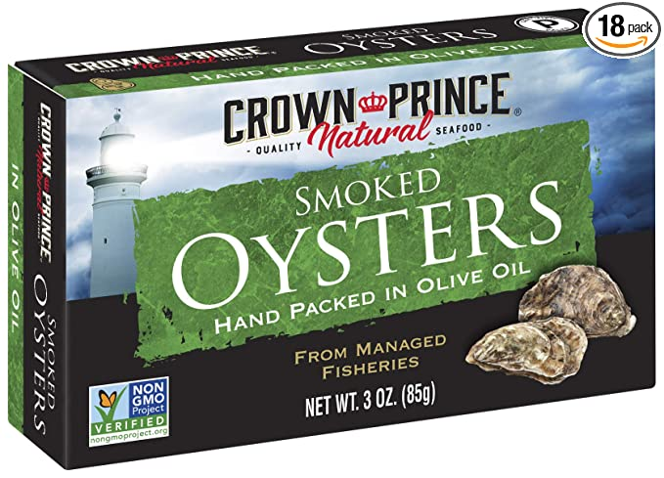

COVID-19 Nutrition Update
An article in the European Journal of Clinical Nutrition suggests the following (1):
  Eating foods that contain or promote the synthesis of serotonin and melatonin at dinner. Almonds, bananas, cherries, and oats contain melatonin. Eating some carbohydrates at dinner can support serotonin.
  Get plenty of zinc – poultry, red meat, pumpkin seeds, oysters
  Eat fish, liver, and egg yolks for vitamin D
  Increase antioxidant nutrients, such as beta carotene, found in sweet potatoes, carrots, and green leafy vegetables
  Increase vitamin C, found in red peppers, oranges, strawberries, broccoli, mangoes, and lemons

Slide 3
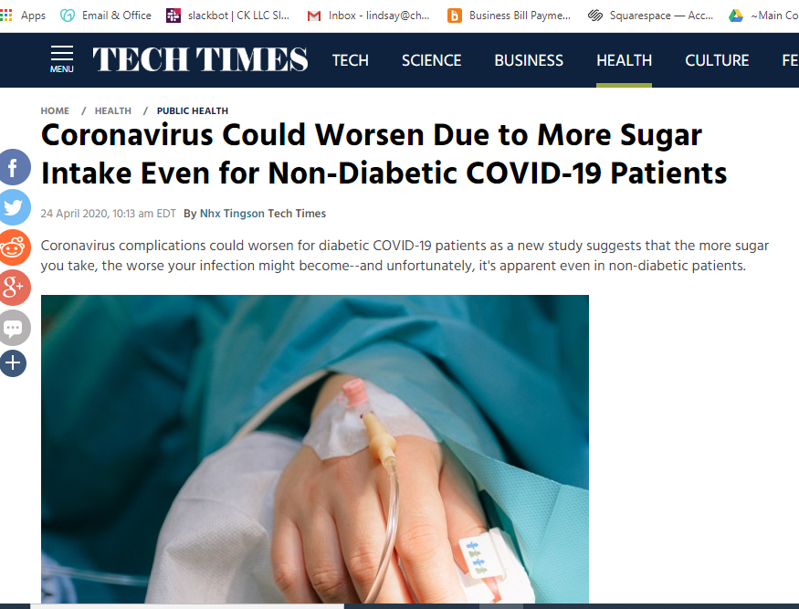
COVID-19 Nutrition Update
Managing blood sugar is crucial
The ACE2 receptor that SARS-CoV-2 uses to enter host cells is activated by the presence of sugar (2)
  The author of this study commented that “…when I talked to physicians around the country taking care of COVID-19 patients, they told me that a lot of their patients in the hospital not only had diabetes and prediabetes but others had high blood sugar, without being aware of it.” (3)
  Diabetes is a major risk factor for COVID (4)
  Hemoglobin A1c has been suggested as a biomarker for identifying at-risk people
Avoid refined carbs
Choose nutrient-dense carbs such as sweet potato, winter squash, plantains, taro, berries, and apples

Slide 4

Tips for Managing Blood Sugar with Nutrition
Eat balanced portions of protein, non-starchy veggies, fat, and carbs at meals. Avoid eating carbs on their own.
Take a walk after meals. This helps shuttle sugar to your muscles so that some of it is used immediately, lowering blood sugar levels. being sure to wear your mask and maintain six feet of physical distance from others. (5)
Manage stress. Stress impacts blood sugar.
Prioritize sleep. Getting sufficient high-quality sleep supports healthy blood sugar levels.
Fit in some physical activity each day.

Slide 5
References
Muscogiuri G, et al. Nutritional recommendations for CoVID-19 quarantine. Eur J Clin Nutr. 2020. [online].
Brufsky A. Hyperglycemia, Hydroxychloroquine, and the COVID‐19 Epidemic. J Med Virol. 2020. [online].
Brufsky A. Blood sugar levels may influence vulnerability to coronavirus, and controlling them through conventional means might be protective. The Conversation. Published 22 April 2020. Accessed 23 April 2020. https://theconversation.com/blood-sugar-levels-may-influence-vulnerability-to-coronavirus-and-controlling-them-through-conventional-means-might-be-protective-136592.
Hussain A, et al. COVID-19 and Diabetes: Knowledge in Progress. Diabetes Res Clin Pract. 2020. 108142.
Reynolds AN and Venn BJ. The timing of activity after eating affects the glycaemic response of healthy adults: A randomised controlled trial. Nutrients. 2018; 10(11): 1743.

