Slide 1
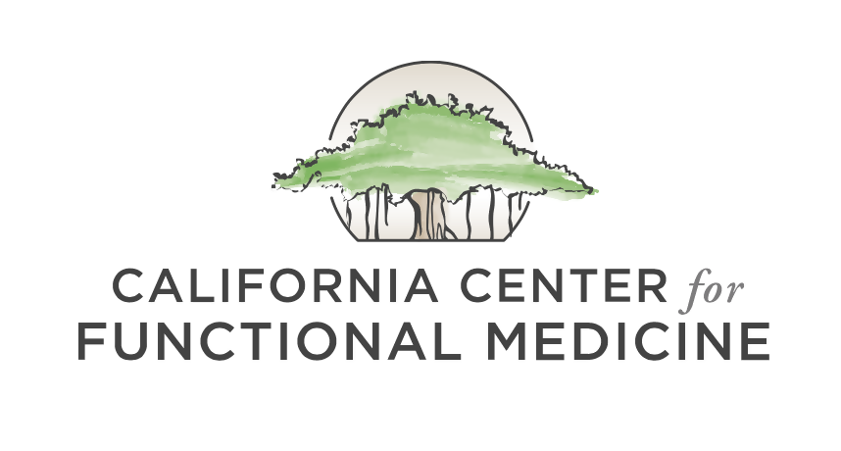

COVID-19 UPDATE
Mindful Eating for Stressful Times
Lindsay Christensen, MS, CNS
April 17th, 2020
©2020 All Rights Reserved, California Center for Functional Medicine

Slide 2
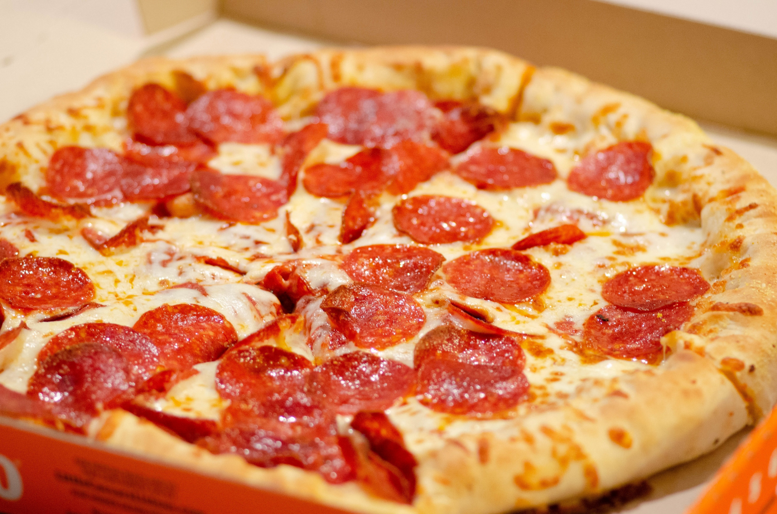
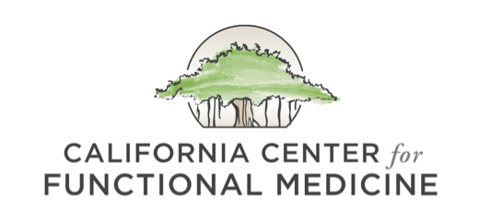
Stress Impacts Our Food Choices
Multiple factors are conspiring to disrupt healthy eating habits right now:
  Psychological stress can trigger poor dietary choices and emotional eating. (1)
    These effects are mediated by changes in the HPA axis, glucose metabolism, and other appetite-related hormones.
  Most people are working from home all day, and the fridge is easily in reach.
  The loss of a daily routine alone can increase anxiety and trigger unhealthy eating behaviors
  Boredom is also a trigger for mindless eating (2)
  Some people may stop eating due to anxiety-induced loss of appetite
It may feel good to eat that piece of pizza in the moment, but the blood sugar roller coaster that follows may make your mood even worse!

Slide 3

Mindfulness Supports Healthy Eating Behaviors
When you find yourself reaching for junky foods, try to slow down and ask yourself “why am I reaching for these foods?”
  Are you feeling tired, lonely, or anxious? Or are you truly hungry?
  If you are not hungry, can you find a non-food way to comfort your mind and body?
  If you are truly hungry, can you pivot and reach for something nutrient-dense, nourishing, and good for your immune system instead?
If you have trouble slowing yourself down when food cravings strike, beginning a daily mindfulness practice may help. (3) Consider trying the Eat Right Now app.
Create a list of non-food activities that feel nourishing to your body. Post the list in a location in your house where you’ll see it throughout each day.

Slide 4

Tips for Mindful, Healthy Eating During Stressful Times
Establish set meal times.
  This could look like eating three “square meals” a day or, if you intermittent fast, two meals a day.
  This is helpful both for people who are grazing all day and those who are struggling to eat.
Eat with your family, rather than alone.
  If you live alone, consider arranging a virtual mealtime with family members over Skype or Zoom.
Sit down in a chair, at a table to eat.
  Avoid eating in front of the TV, as research suggests that this leads to excessive calorie intake and that subconscious memory of that food intake is impaired.
Don’t forget to chew your food!
Manage your environment.
  If you have a lot of junk food sitting around at home, it may be best to pitch it.

Slide 5
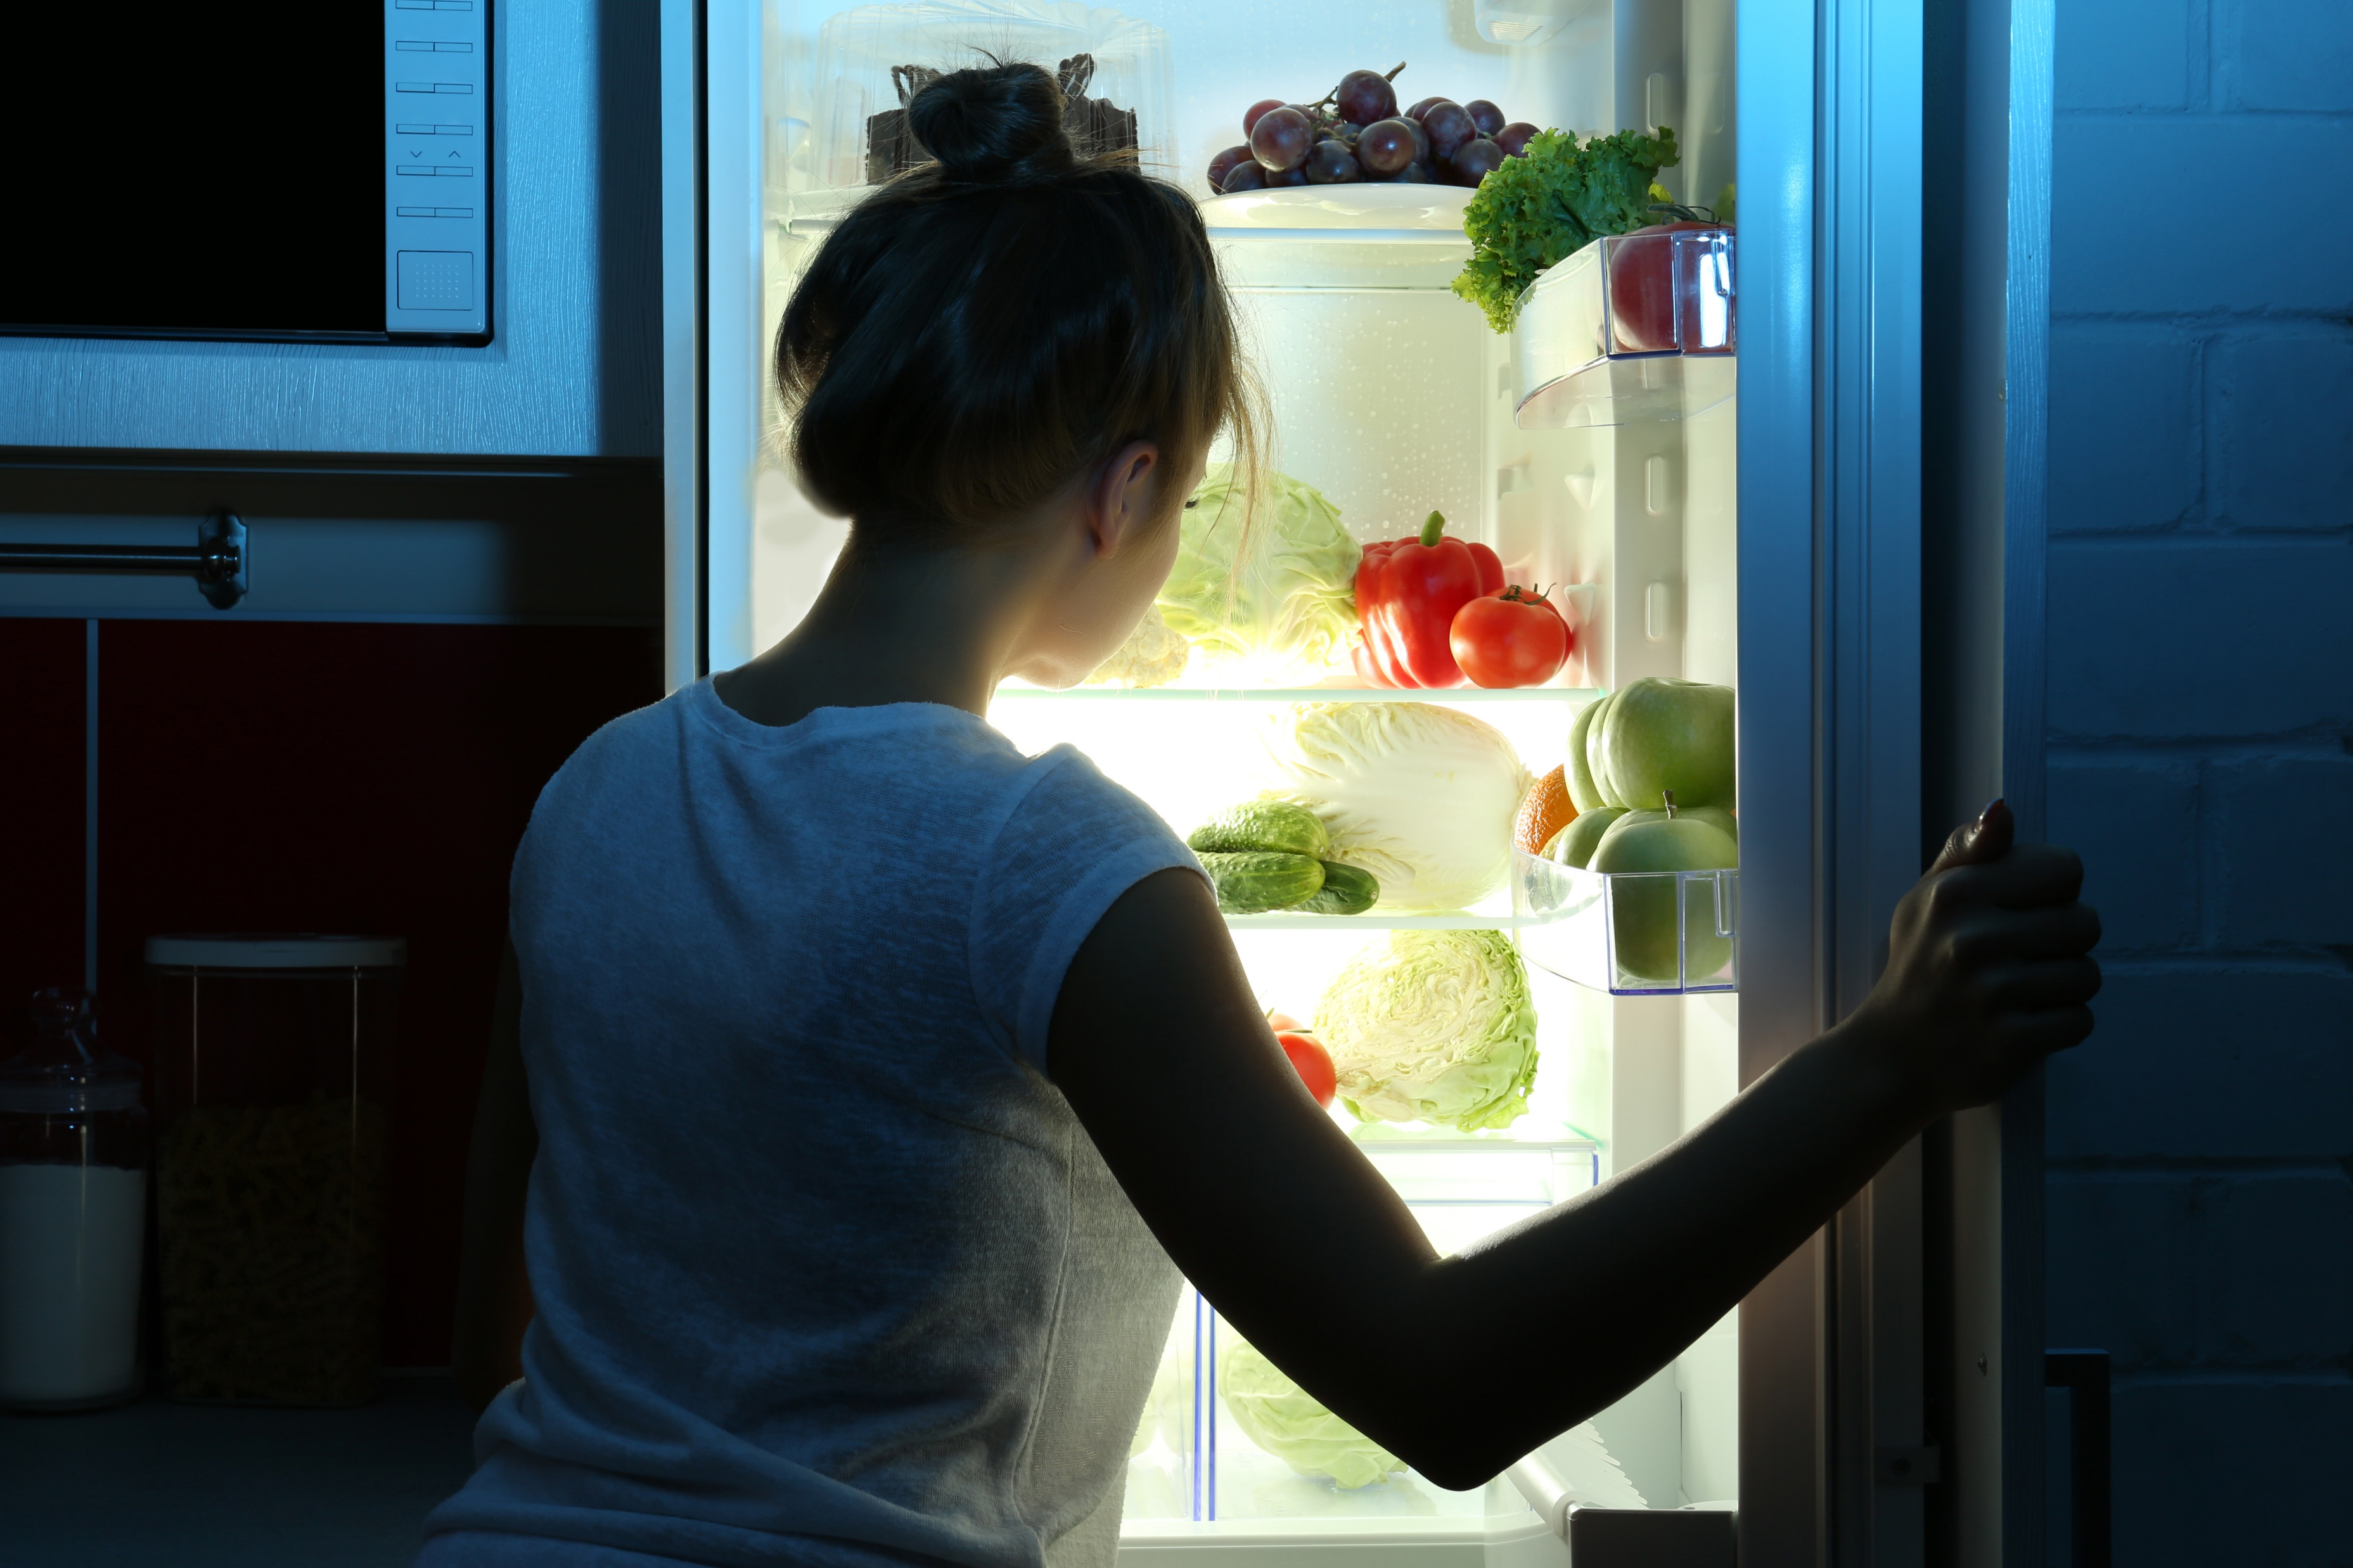
Additional Tips
Blue light-blocking glasses at night may reduce nighttime eating
  Evening blue light exposure may increase hunger and sugar intake at night, according to preclinical research in diurnal rodents. (4)
Use an app such as Zero to track your overnight fast.
Make sure you eat a balance of protein, carbs, and fat at dinner.
Establish a consistent bedtime and waking time.

Slide 6

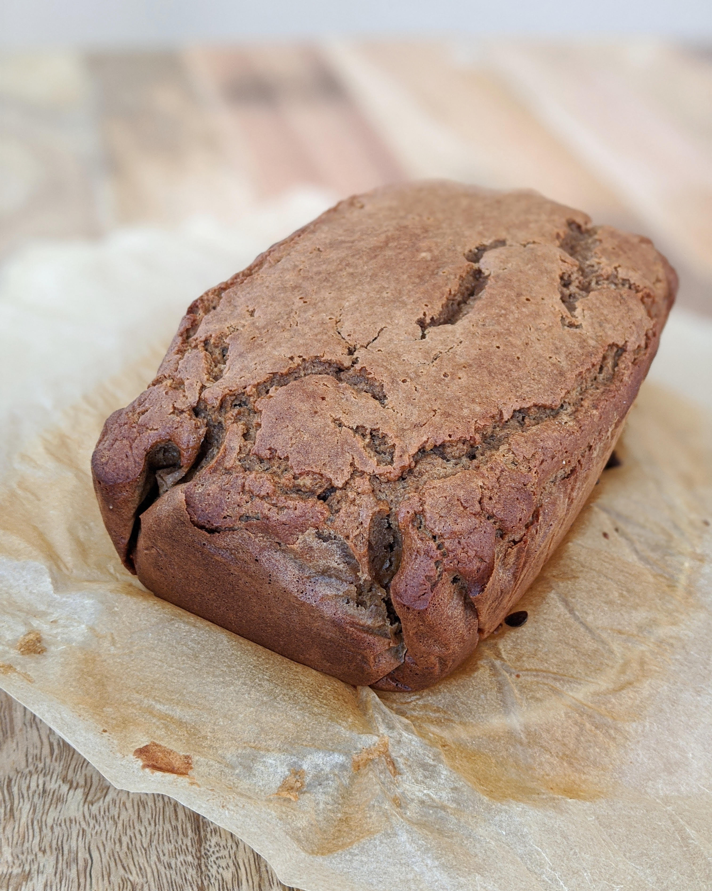
Tips for Healthy Eating During Stressful Times
Choose a day to food prep each week. Having healthy food options readily available will reduce decision fatigue when you are hungry later on.
Keep meals simple. You do not need to create Instagram-worthy meals!
  Ground beef with sautéed greens, garlic, and a baked sweet potato
  Eggs, sauerkraut, and a baked or fried plantain
  Salad with canned salmon or sardines, chopped raw veggies, and balsamic vinegar/olive oil dressing
Give yourself permission to enjoy some comfort foods, but try to make them as healthy as possible.
  Think “upgraded comfort food.” Optimal nutrition really is key right now for immunity.

Slide 7
References
Yau YHC, et al. Stress and eating behaviors. Minerva Endocrinol. 2013; 38(3): 255-267.
Moynihan AB, et al. Eaten up by boredom: consuming food to escape awareness of the bored self. Front Psychol. 2015; 6: 369.
Warren JM, et al. A structured literature review on the role of mindfulness, mindful eating and intuitive eating in changing eating behaviours: Effectiveness and associated potential mechanisms. Nutr Res Rev. 2017; 30(2): 272-283.
Masis-Vargas A, et al. Blue light at night acutely impairs glucose tolerance and increases sugar intake in the diurnal rodent Arvicanthis ansorgei in a sex‐dependent manner. Physiol Rep. 2019; 7(20): e14257.

