Slide 1
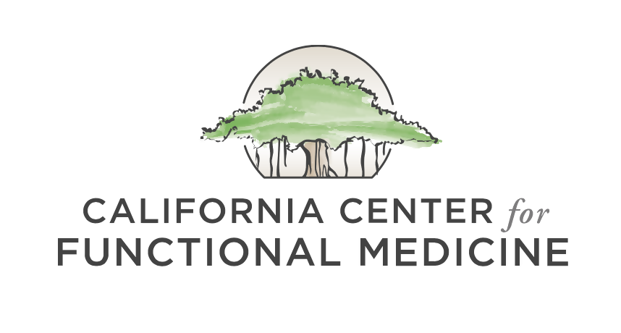

COVID-19 UPDATE
COVID-19 Nutrition Updates
Lindsay Christensen, MS, CNS
May 1st, 2020
©2020 All Rights Reserved, California Center for Functional Medicine

Slide 2
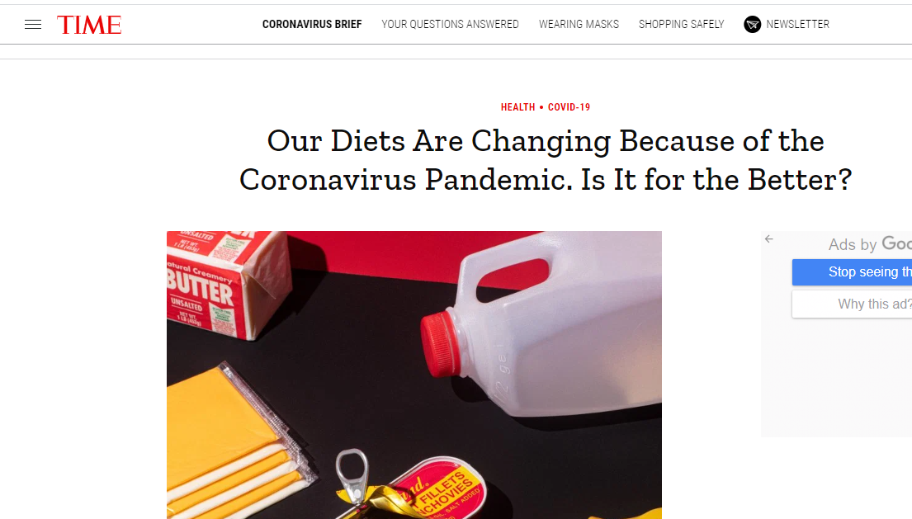

COVID-19, Our Eating Patterns, and the Food System
COVID is impacting our eating patterns in interesting ways.
The good:
  Web traffic to cooking website is surging (1)
  In a recent survey of 1,000 Americans, ~50% said they are cooking more at home and 38% said they are ordering less takeout. (2) This is encouraging, considering that Americans get ~20% of their calories from restaurant food. (3)

Slide 3
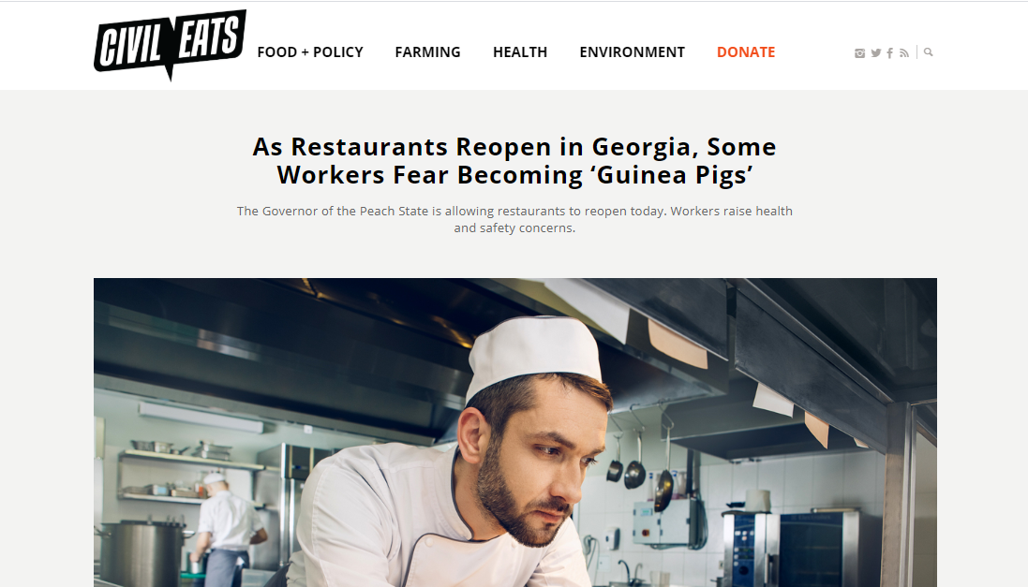
COVID-19, Our Eating Patterns, and the Food System
The bad:
  Sales of flour, sugar, and alcohol are surging
  People are turning to comfort food
  “… the relationship between cooking more frequently and having a better diet only holds true for higher income households.” (4)
  COVID is widening nutritional disparities between the wealthy and working-class Americans
  Restaurants are reopening in some locations – restaurant workers may be put back at undue risk

Slide 4
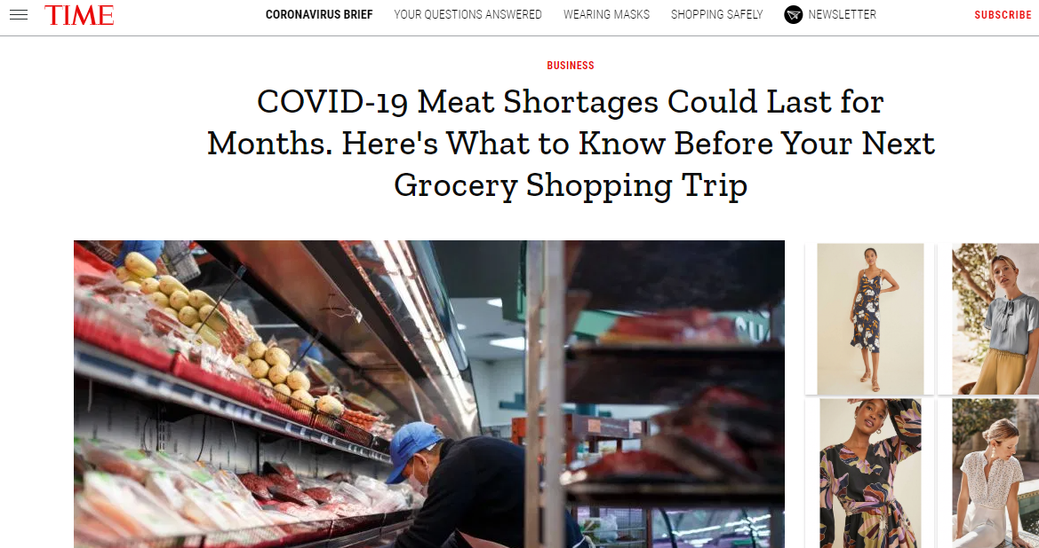
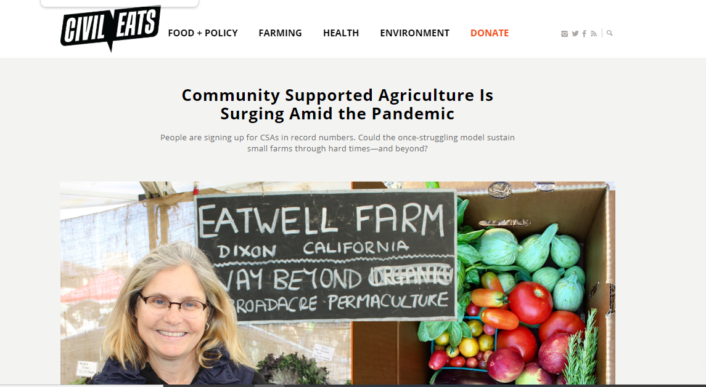
Changes to Food Supply Chains
Possible meat shortages on the horizon
  In the coming weeks, grocery stores may have less meat available
  Consider finding local farms near you that sell meat and poultry
  Meat prices may rise
  Meat availability may begin to improve by June as processing plants implement new strategies for keeping workers safe (5)
Community Supported Agriculture (CSAs) is doing well.
  Now is a good time to join a CSA – many are still taking new members as most begin sending out produce in mid- to late May.
  Check out EatWild to find small farms near you: http://www.eatwild.com/
  Local Harvest is a good resource for finding CSAs near you: https://www.localharvest.org/csa/

Slide 5
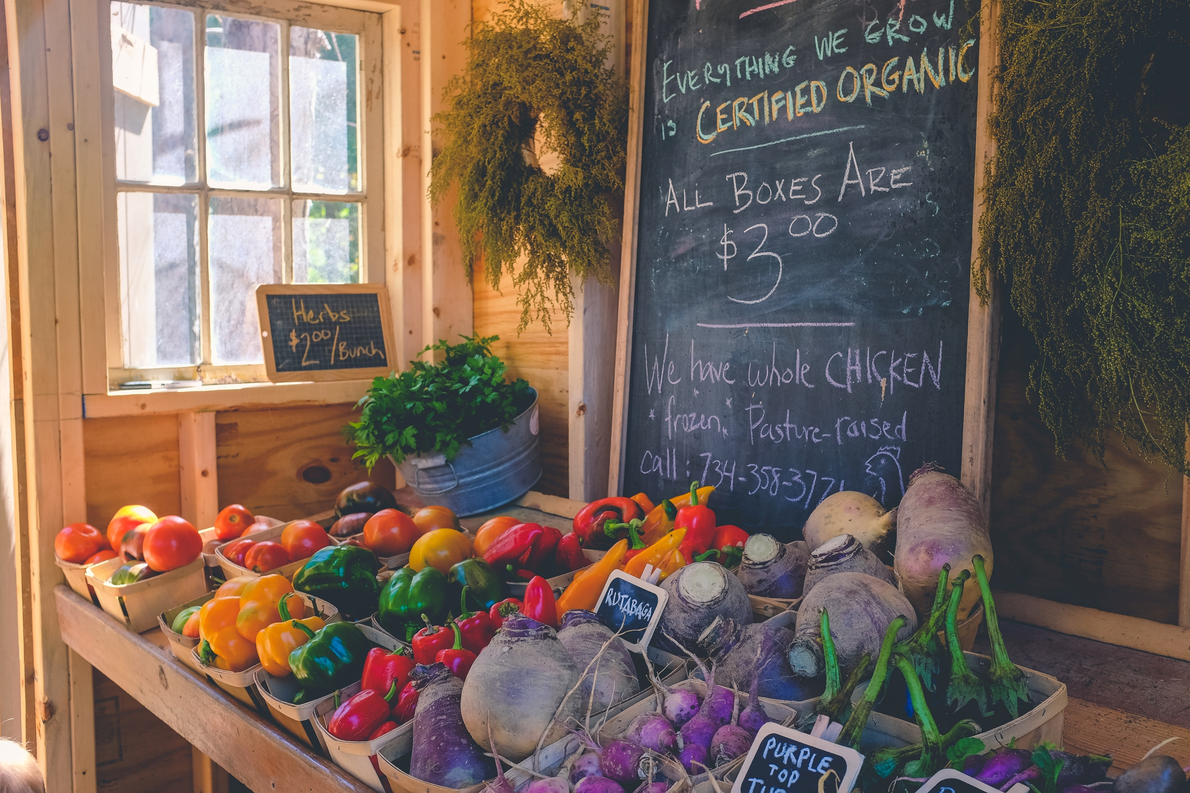
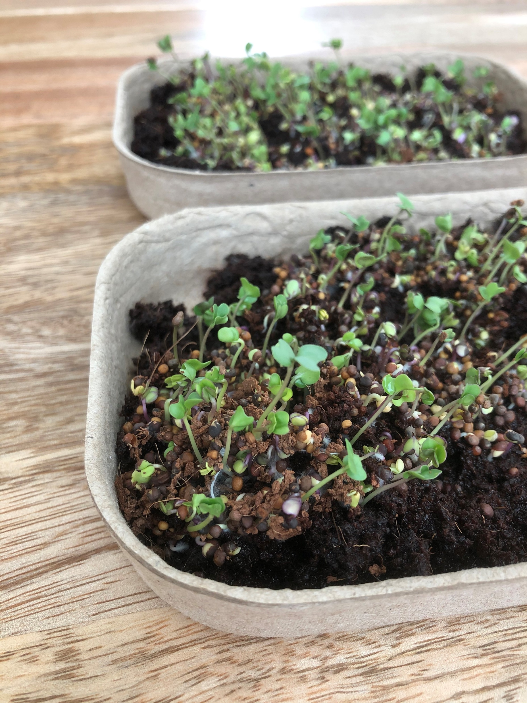
Key Takeaways
Consider joining a CSA
If you have the resources, consider donating to a local soup kitchen or food pantry - can donate time, money, or food (in some locations)
  Feeding America: https://www.feedingamerica.org/take-action/coronavirus
If you are going to eat restaurant food, try to choose a healthy restaurant and order it as takeout so you can eat it at home.
If you’ve begun cooking more healthy meals at home, keep up the good work!
Consider starting a garden or, if you don’t have a yard, growing plants in pots on a balcony. You can even grow some veggies, such as microgreens and sprouts, indoors.
  Back to the Roots for indoor growing kits: https://backtotheroots.com/

Slide 6
References
Lundstrom A. cooking websites see a traffic boost as people are urged to stay home. Adweek. Published 8 April 2020. Accessed 1 May 2020. https://www.adweek.com/digital/cooking-websites-see-a-traffic-boost-as-people-are-urged-to-stay-home/.
“HUNTER: Food study special report, America gets cooking.” Hunter Food Study 2020. Published 9 April 2020. Accessed 1 May 2020. https://www.slideshare.net/HUNTERNY/hunter-food-study-special-report-america-gets-cooking-231713331.
Liu J, et al. Quality of meals consumed by US adults at full-service and fast-food restaurants, 2003-2016: Persistent low quality and widening disparities. J Nutr. 150(4): 873-883.
Oaklander M. Our diets are changing because of the coronavirus pandemic. Is it for the better? Time. Published 28 April 2020. Accessed 1 May 2020. https://time.com/5827315/coronavirus-diet/.
Law T. COVID-19 Meat shortages could last for months. Here’s what to know before your next grocery shopping trip. Time. Published 30 April 2020. Accessed 1 May 2020. https://time.com/5830178/meat-shortages-coronavirus/.

